Slide 1
Federated Deep Learning Ranked Signals

Slide 2
2023-2024

Slide 3
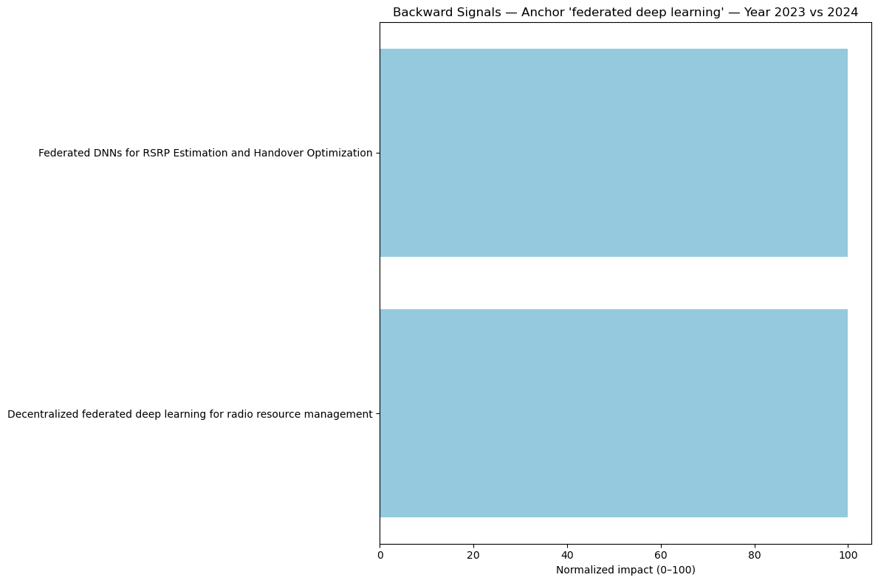

Slide 4
